Slide 1
Block Modeling-Guided Graph Convolutional Neural Networks (AAAI-22)
徐正佳

Slide 2
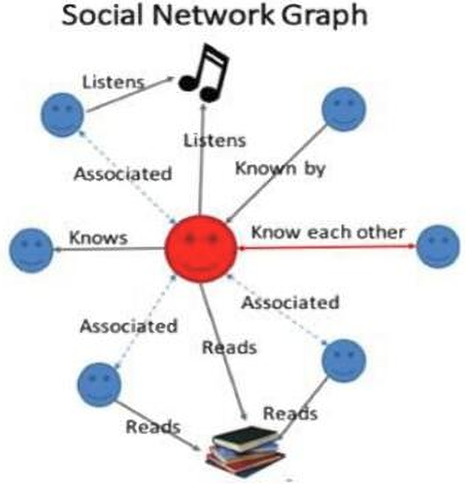
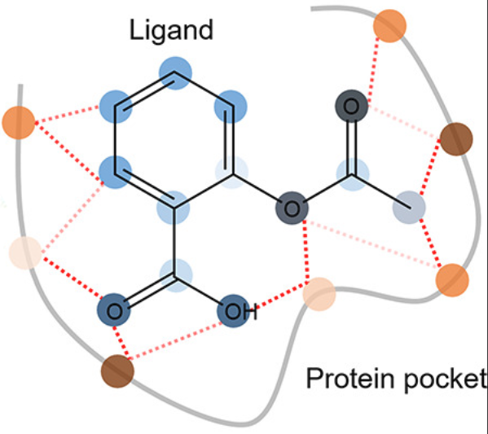

图数据
Graphs can model the relationships between many different types of data, including web pages (left), social connections (center), or molecules (right).
Notes:
Graphs can model the relationships between many different types of data, including web pages (left), social connections (center), or molecules (right). 下面给大家介绍一下图卷积神经网络以及其异质性的问题

Slide 3
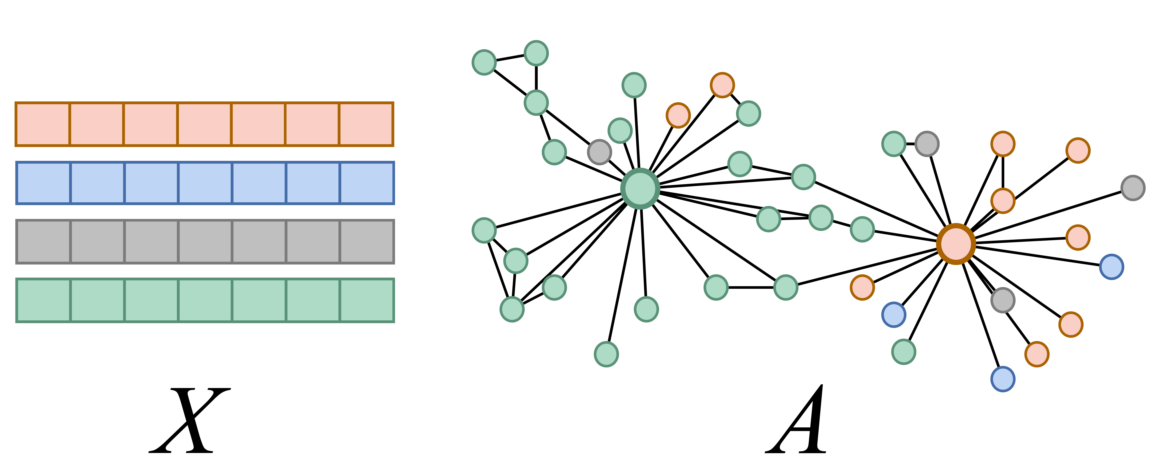
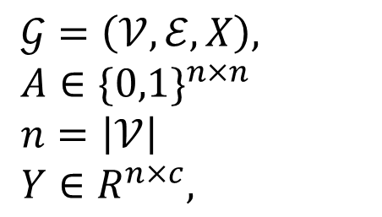
Preliminaries
-
$$X Feature Matrix$$
$𝒢=\left(𝒱,ℰ,X\right),$
$A∈\{0,1\}^{n×n}$
$n=\left|𝒱\right|$
$Y∈R^{n×c},$
-
$c Number of classes$

Slide 4
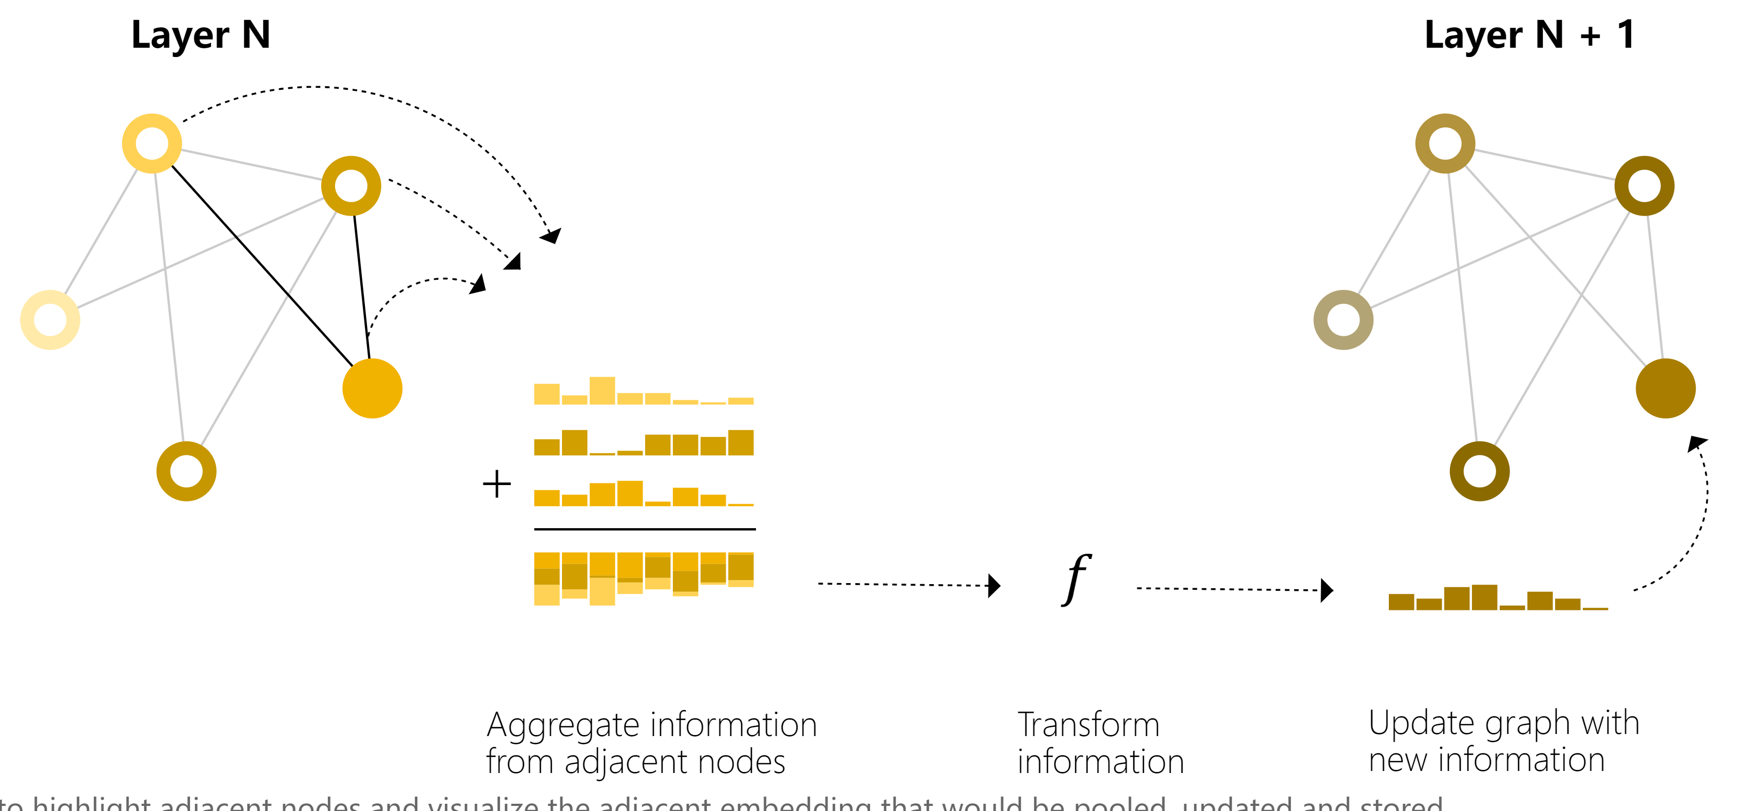
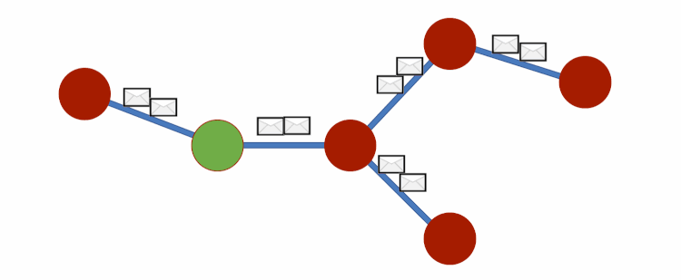
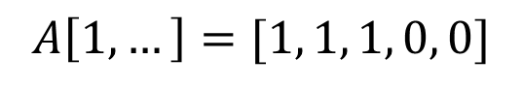
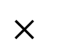
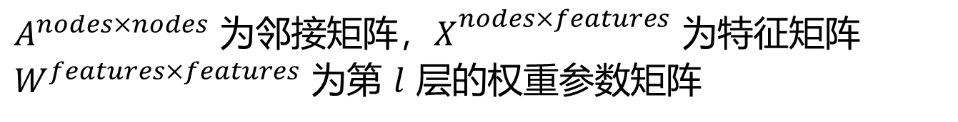
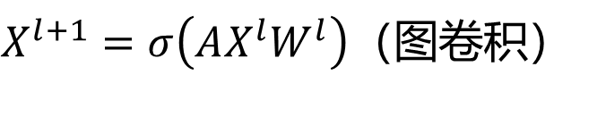
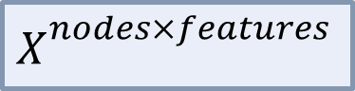
Graph Convolution Network (GCN)
聚合了图中的其它节点的信息后接上MLP来做分类、回归等下游任务
3
2
4
1
1
2
3
4
5
5
$$A\left[1, …\right]=[1, 1, 1, 0, 0]$$
1
2
$$×$$
$X_{{}}^{nodes×features}$
3
4
消息传递机制 (Message Passing)
5
$X^{l+1}=σ\left(AX^{l}W^{l}\right)$（图卷积）
$A^{nodes×nodes}$ 为邻接矩阵，$X_{{}}^{nodes×features}$ 为特征矩阵 $W^{features×features}$ 为第 $l$ 层的权重参数矩阵
Notes:
那么怎么利用 topology 呢？对于每个节点的，让它“看到”它的邻居，也就是说我们去对这些信息做沿着 graph structure 一个聚合，将这些信息汇总到一个向量里 l: 聚合一次就聚合了一阶邻居的信息

Slide 5

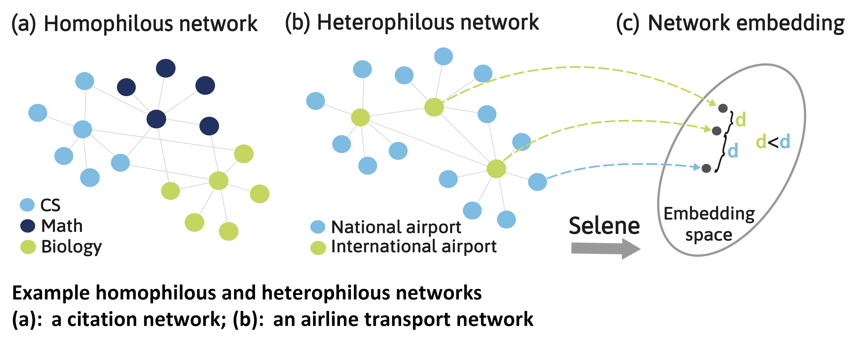
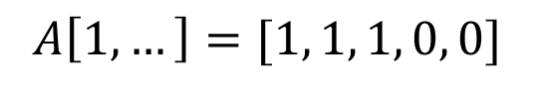
同质性假设（Homophily Assumption）
聚合了图中的其它节点的信息后接上MLP来做分类、回归等下游任务
3
2
4
1
1
2
3
4
5
5
$$A\left[1, …\right]=[1, 1, 1, 0, 0]$$
1
2
$$×$$
$X_{{}}^{nodes×features}$
3
4
消息传递机制 (Message Passing)
5
$X^{l+1}=σ\left(AX^{l}W^{l}\right)$（图卷积）
$A^{nodes×nodes}$ 为邻接矩阵，$X_{{}}^{nodes×features}$ 为特征矩阵 $W^{features×features}$ 为第 $l$ 层的权重参数矩阵
Notes:
图中的相连节点可能有不同的 class 和不相似的 features，很多流行的 GNN 不能泛化至此情，甚至被忽视图结构的模型超越（也就是说不仅没利用好图结构，甚至反而是负收益的）

Slide 6
Related Work
Aggregating higher-order neighbors:
H2GCN [Zhu et al., 2020]
MixHop [Abu-El-Haija et al., 2019]
…
Passing signed messages (给邻居设计权重):
GGCN [Yan et al., 2021]
GPR-GNN [Chien et al., 2019]
…
Both:
GAGA [Wang et al., 2023]
…
Damage the network topology. May be over-smoothing. (邻域爆炸)
Fail to define a optimal aggregating mechanism.
Automatically learned corresponding aggregation rules for neighbors of different classes in a fast manner^{[1]}
[1] He, Dongxiao, et al. "Block modeling-guided graph convolutional neural networks." Proceedings of the AAAI Conference on Artificial Intelligence. Vol. 36. No. 4. 2022.
Notes:
H2GCN、MixHop：聚合更高阶邻域的信息，缓解通过聚合来自直接邻域的信息所引发的异质性问题。但是：破坏了拓扑结构，因为聚合了高阶邻居的信息（例如H2GCN就是将多阶邻居拼在一起），可能带来 over-smothing
GGCN和GPR-GNN：signed messages ，就是加个权重，但是如果pair-wise地用相似度计算，计算很大，平等对待每个邻居效果又不好
Motivation: task-topology incordance

Slide 7
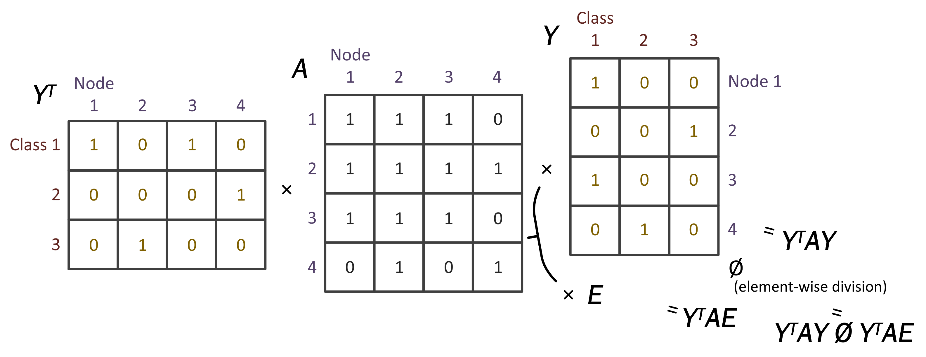
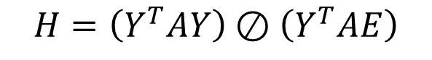
Block Matrix (Class-Connecting Probability Matrix)
$$H=\left(Y^{T}AY\right)⊘\left(Y^{T}AE\right)$$
[1] He, Dongxiao, et al. "Block modeling-guided graph convolutional neural networks." Proceedings of the AAAI Conference on Artificial Intelligence. Vol. 36. No. 4. 2022.

Slide 8
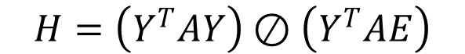
Block Matrix (Class-Connecting Probability Matrix)
$$H=\left(Y^{T}AY\right)⊘\left(Y^{T}AE\right)$$
Y
A[1, 3]
T
1
1
0
1
0
·
1
=
2
属于 class 的 nodes 和 node 有边连接的数量
1
1
3
0
[1] He, Dongxiao, et al. "Block modeling-guided graph convolutional neural networks." Proceedings of the AAAI Conference on Artificial Intelligence. Vol. 36. No. 4. 2022.
Notes:
图中的相连节点可能有不同的 class 和不相似的 features，很多流行的 GNN 不能泛化至此情，甚至被忽视图结构的模型超越（也就是说不仅没利用好图结构，甚至反而是负收益的）

Slide 9
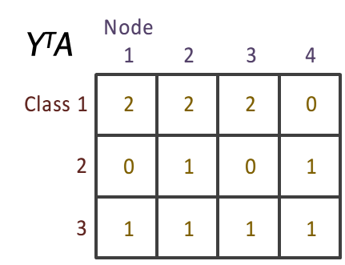
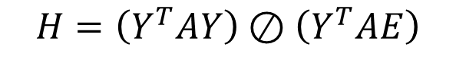
Block Matrix (Class-Connecting Probability Matrix)
$$H=\left(Y^{T}AY\right)⊘\left(Y^{T}AE\right)$$
j
属于 class 的 nodes 和 node 有边连接的数量
i
[1] He, Dongxiao, et al. "Block modeling-guided graph convolutional neural networks." Proceedings of the AAAI Conference on Artificial Intelligence. Vol. 36. No. 4. 2022.

Slide 10
Block Matrix (Class-Connecting Probability Matrix)
$$H=\left(Y^{T}AY\right)⊘\left(Y^{T}AE\right)$$
0
·
1
=
2
1
属于 class 的 nodes 和属于 class 的 nodes 有边连接的数量
3
0
0
j
属于 class 的 nodes 和 node 有边连接的数量
i
[1] He, Dongxiao, et al. "Block modeling-guided graph convolutional neural networks." Proceedings of the AAAI Conference on Artificial Intelligence. Vol. 36. No. 4. 2022.

Slide 11

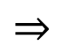
Block Matrix (Class-Connecting Probability Matrix)
$$H=\left(Y^{T}AY\right)⊘\left(Y^{T}AE\right)$$
0
·
1
属于 class 的 nodes 和属于 class 的 nodes 有边连接的数量
1
=
2
3
0
Y
Class
0
T
AY
1
2
3
j
属于 class 的 nodes 和 node 有边连接的数量
i
$$⇒$$
Class 1
4
0
2
2
0
1
1
[1] He, Dongxiao, et al. "Block modeling-guided graph convolutional neural networks." Proceedings of the AAAI Conference on Artificial Intelligence. Vol. 36. No. 4. 2022.
3
2
1
1

Slide 12
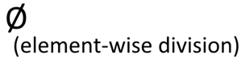
Block Matrix (Class-Connecting Probability Matrix)
$$H=\left(Y^{T}AY\right)⊘\left(Y^{T}AE\right)$$
Y
Class
1
1
1
T
AY
1
1
1
1
2
3
Class
1
1
1
Y
T
AE
1
1
1
Class 1
4
0
2
1
2
3
Y
T
AY
Ø
Class
Class 1
6
6
6
1
2
3
2
0
1
1
Y
T
AE
=
Class 1
0.67
0
0.33
2
2
2
2
class 与 class 间的连边概率
3
2
1
1
2
0
0.5
0.5
3
4
4
4
class 与 class 间的连边数
3
0.5
0.25
0.25
[1] He, Dongxiao, et al. "Block modeling-guided graph convolutional neural networks." Proceedings of the AAAI Conference on Artificial Intelligence. Vol. 36. No. 4. 2022.

Slide 13

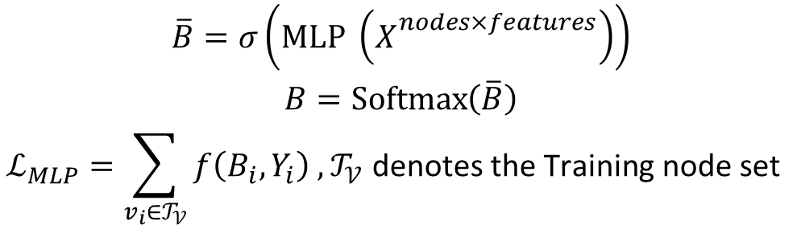
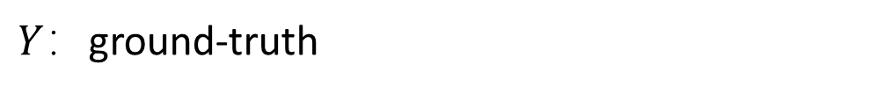
Block Matrix (Class-Connecting Probability Matrix)
$$H=\left(Y^{T}AY\right)⊘\left(Y^{T}AE\right)$$
$Y$：ground-truth
What if we can’t not see all ground-truth, lacking labels which need us to predict?
Infer the soft labels by semi-supervised learning.
$$\begin{aligned}\overline{B}=σ\left(MLP \left(X_{{}}^{nodes×features}\right)\right) \\ B=\operatorname{Softmax}\left(\overline{B}\right) \\ ℒ_{MLP}=\sum_{v_{i}∈𝒯_{𝒱}}{f\left(B_{i},Y_{i}\right)} ,𝒯_{𝒱} \text{denotes} \text{the} \text{T}\text{raining} \text{node} \text{set} \end{aligned}$$
$$\begin{aligned}&Y_{s}=\left\{Y_{i},B_{j}∣∀v_{i}∈𝒯_{𝒱},∀v_{j}∉𝒯_{𝒱}\right\} \\ &H=\left(Y_{s}^{T}AY_{s}\right)⊘\left(Y_{s}^{T}AE\right)\end{aligned}$$
[1] He, Dongxiao, et al. "Block modeling-guided graph convolutional neural networks." Proceedings of the AAAI Conference on Artificial Intelligence. Vol. 36. No. 4. 2022.
Notes:
Considering that the soft labels should come from the original data while the topology may be not trustworthy in heterophilic graphs, here BM-GCN uses node attributes alone to generate soft labels. Specifically, BM-GCN adopts a multilayer perception (MLP) to transform node attributes into soft labels

Slide 14
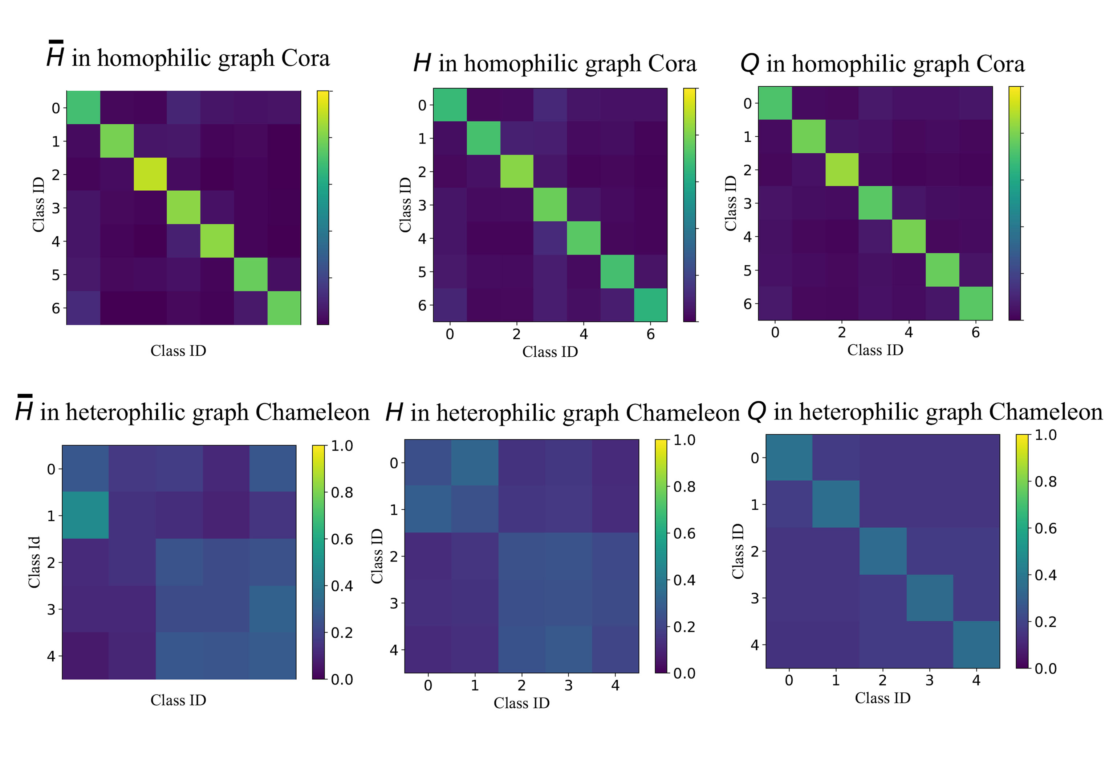
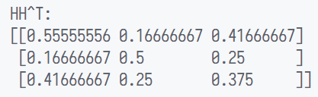

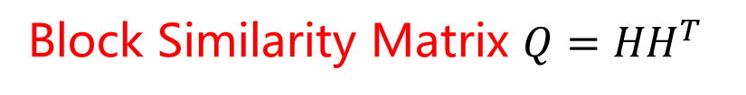
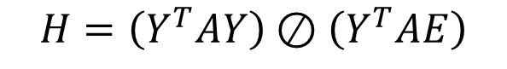
Block Similarity Matrix
$$H=\left(Y^{T}AY\right)⊘\left(Y^{T}AE\right)$$
Y
T
AY
Ø
Class
Y
T
AE
1
2
3
=
Class 1
0.67
0
0.33
2
0
0.5
0.5
3
0.5
0.25
0.25
$$⇒$$
Block Similarity Matrix $Q={HH}^{T}$
$\overline{H}$ calculated on ground truth，$H$ calculated on soft labels learned by MLP
即H 里的 class 俩俩做点积，类与类的 connecting pattern 相似度
[1] He, Dongxiao, et al. "Block modeling-guided graph convolutional neural networks." Proceedings of the AAAI Conference on Artificial Intelligence. Vol. 36. No. 4. 2022.
Notes:
Q in heterophilic graph，对角线上的颜色也更淡，因为 connecting pattern 比同质图要杂
$\overline{H}$ 和 $H$ 看上去挺相似的，说明 soft label 是 make sense 的
但是 H 不能用来引导消息传递，因为在异质图里，H仅仅可以用来表明哪些类的连接程度是比较紧密的（如果是看这个的话，又和直接用 A 的本质思想的区别在哪？还是没有脱离 homophily assumption），比如图中，class 0和class 1的连接概率看上去会比较高，而class 0和其自身反而还比较小。所以需要自×出一个 Q，这其中就蕴含了个假设……

Slide 15
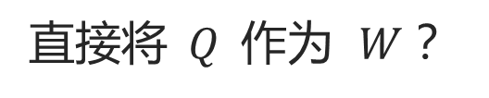
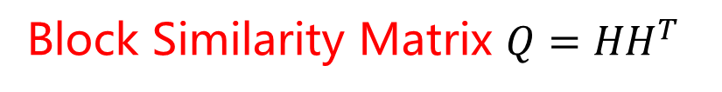
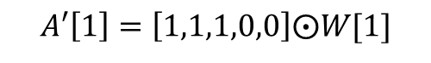
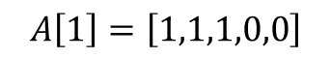
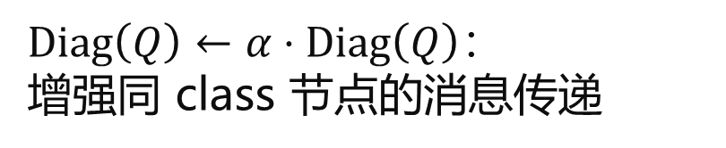
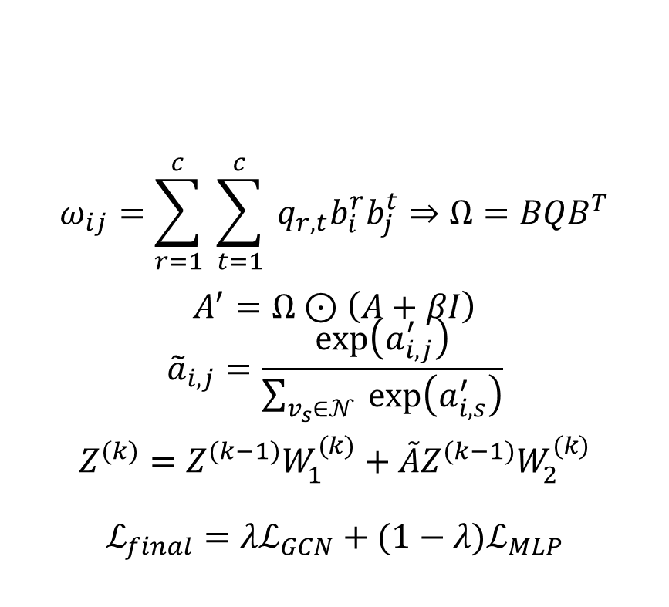
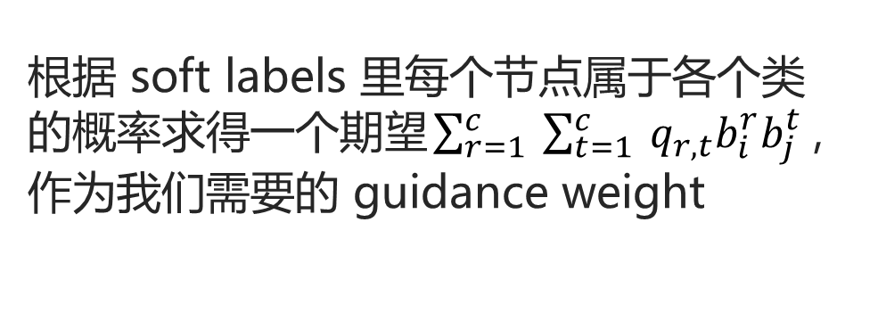
Block-Similarity-Matrix-Guided Message Passing
Block Similarity Matrix $Q={HH}^{T}$
$\operatorname{Diag}\left(Q\right)←α⋅\operatorname{Diag}\left(Q\right)$：
增强同 class 节点的消息传递
即H 里的 class 俩俩做点积，类与类的 connecting pattern 相似度
那么怎么用$Q$ 去 guide 图卷积（消息传递）呢？
$$ω_{ij}=\sum_{r=1}^{c}{ }\sum_{t=1}^{c}{ }q_{r,t}b_{i}^{r}b_{j}^{t}⇒Ω=BQB^{T}$$
$$A^{′}=Ω⊙\left(A+βI\right)$$
$${\tilde{a}}_{i,j}=\frac{\exp\left(a_{i,j}^{′}\right)}{\sum_{v_{s}∈𝒩}{ }exp⁡\left(a_{i,s}^{′}\right)}$$
$$Z^{(k)}=Z^{(k−1)}W_{1}^{(k)}+\tilde{A}Z^{(k−1)}W_{2}^{(k)}$$
$$ℒ_{final}=λℒ_{GCN}+(1−λ)ℒ_{MLP}$$
Origin：
Guided：
$$A\left[1\right]=\left[1,1,1,0,0\right]$$
$$A′\left[1\right]=\left[1,1,1,0,0\right]⨀W[1]$$
直接将$Q$作为 $W$？
需要知道所有节点的 label
根据 soft labels 里每个节点属于各个类的概率求得一个期望$\sum_{r=1}^{c}{ }\sum_{t=1}^{c}{ }q_{r,t}b_{i}^{r}b_{j}^{t}$，作为我们需要的 guidance weight
[1] He, Dongxiao, et al. "Block modeling-guided graph convolutional neural networks." Proceedings of the AAAI Conference on Artificial Intelligence. Vol. 36. No. 4. 2022.

Slide 16
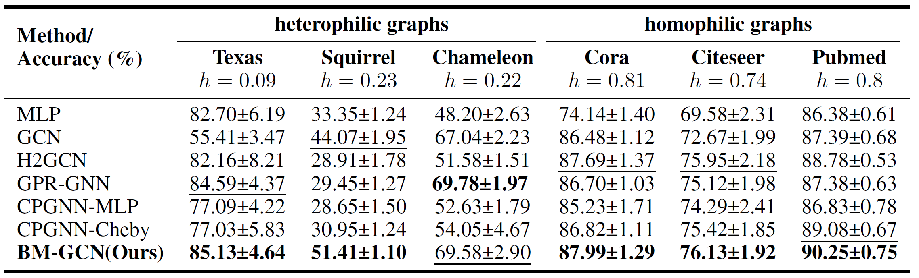

Experiments
$$h=\frac{1}{\left|𝒱\right|}\sum_{v_{i}∈𝒱}{ }\frac{\left|\left\{v_{j}∣v_{j}∈𝒩_{i},Y_{j}=Y_{i}\right\}\right|}{\left|𝒩_{i}\right|}$$
[1] He, Dongxiao, et al. "Block modeling-guided graph convolutional neural networks." Proceedings of the AAAI Conference on Artificial Intelligence. Vol. 36. No. 4. 2022.
Notes:
松鼠数据集，变色龙数据集已被指出有问题

Slide 17
Experiments
Visualization results on Chameleon dataset. Different colors correspond to different ground truth classes.
[1] He, Dongxiao, et al. "Block modeling-guided graph convolutional neural networks." Proceedings of the AAAI Conference on Artificial Intelligence. Vol. 36. No. 4. 2022.

Slide 18
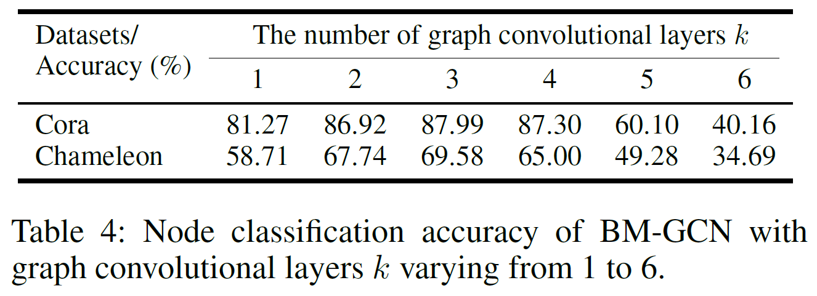
Experiments
[1] He, Dongxiao, et al. "Block modeling-guided graph convolutional neural networks." Proceedings of the AAAI Conference on Artificial Intelligence. Vol. 36. No. 4. 2022.
Notes:
一般经典的 GCN 就两层，但是这个 BM-GCN 可以深点，可能因为经过 block-guided 后，多层的聚合后积累的是噪声更少

Slide 19
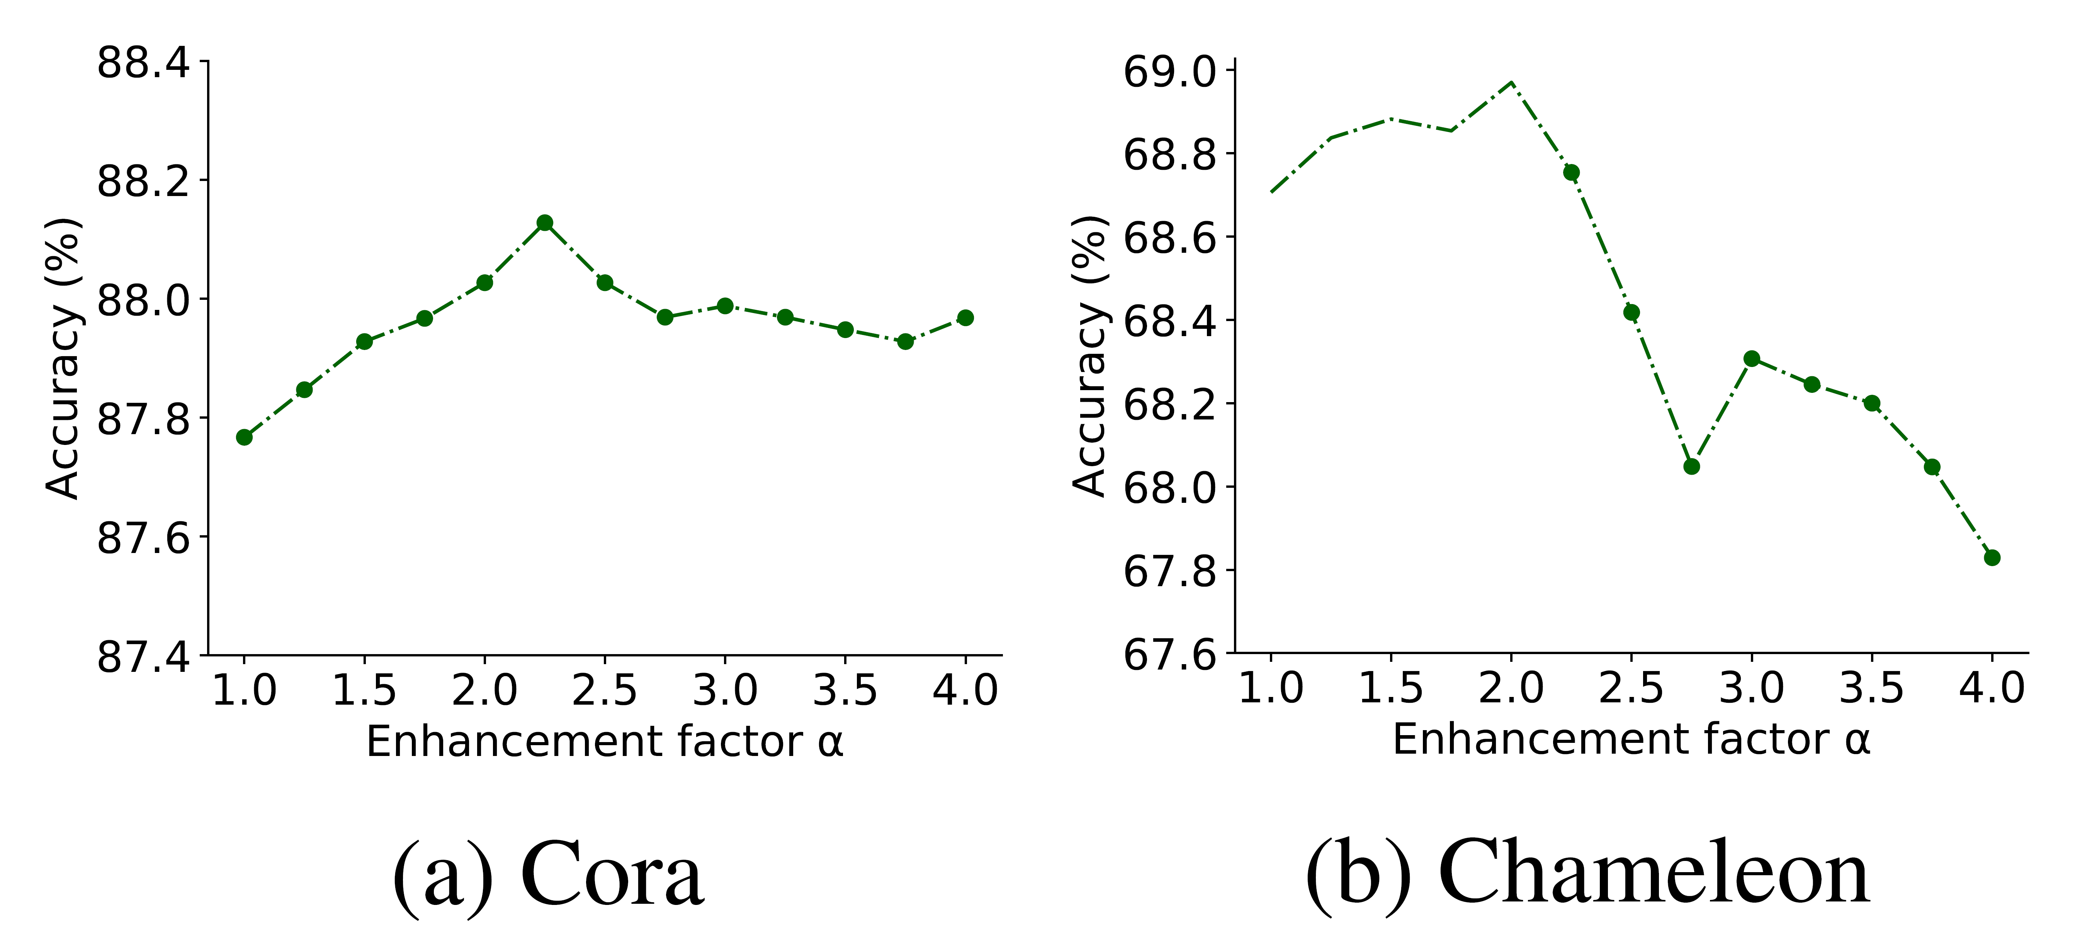
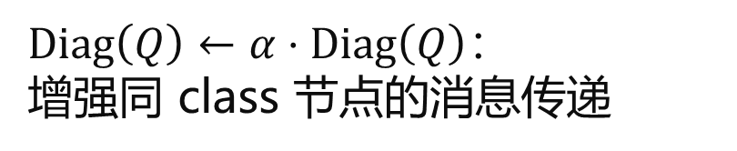
Experiments
$\operatorname{Diag}\left(Q\right)←α⋅\operatorname{Diag}\left(Q\right)$：
增强同 class 节点的消息传递
[1] He, Dongxiao, et al. "Block modeling-guided graph convolutional neural networks." Proceedings of the AAAI Conference on Artificial Intelligence. Vol. 36. No. 4. 2022.

Slide 20
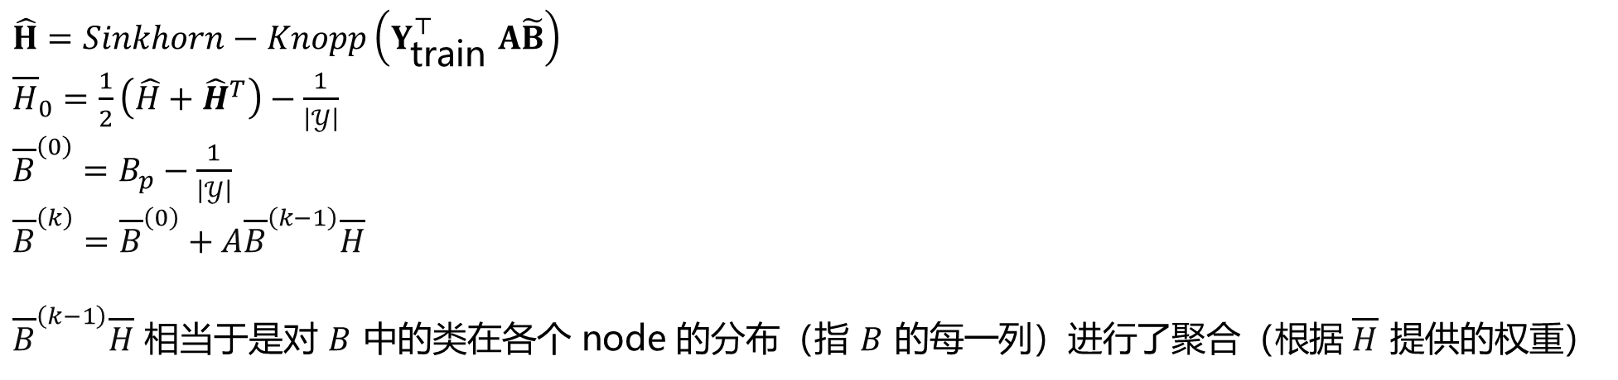
Compared to CPGNN^{[2]}
$\hat{H}=Sinkhorn−\operatorname{Knopp}\left(Y_{\text{train} }^{⊤}A\tilde{B}\right)$
${\overline{H}}_{0}=\frac{1}{2}\left(\hat{H}+{\hat{H}}^{T}\right)−\frac{1}{\left|𝒴\right|}$
${\overline{B}}^{\left(0\right)}=B_{p}−\frac{1}{\left|𝒴\right|}$
${\overline{B}}^{\left(k\right)}={\overline{B}}^{\left(0\right)}+A{\overline{B}}^{\left(k−1\right)}\overline{H}$
${\overline{B}}^{\left(k−1\right)}\overline{H}$ 相当于是对 $B$ 中的类在各个 node 的分布（指 $B$ 的每一列）进行了聚合（根据$\overline{H}$ 提供的权重）
Multiplied by H
Class
1
2
3
Node 1
2
3
4
[2] Zhu, Jiong, et al. "Graph neural networks with heterophily." Proceedings of the AAAI Conference on Artificial Intelligence. Vol. 35. No. 12. 2021.

Slide 21
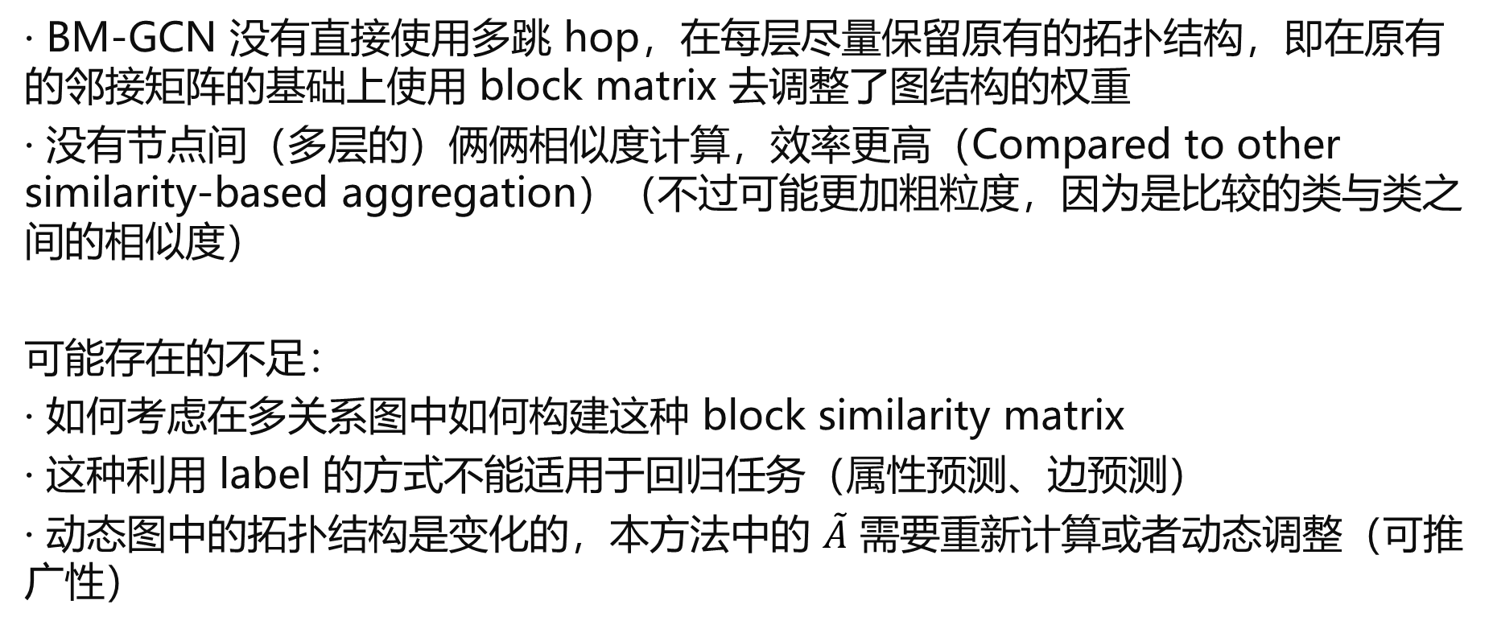
总结与思考
· BM-GCN 没有直接使用多跳 hop，在每层尽量保留原有的拓扑结构，即在原有的邻接矩阵的基础上使用 block matrix 去调整了图结构的权重
· 没有节点间（多层的）俩俩相似度计算，效率更高（Compared to other similarity-based aggregation）（不过可能更加粗粒度，因为是比较的类与类之间的相似度）
可能存在的不足：
· 如何考虑在多关系图中如何构建这种 block similarity matrix
· 这种利用 label 的方式不能适用于回归任务（属性预测、边预测）
· 动态图中的拓扑结构是变化的，本方法中的 $\tilde{A}$ 需要重新计算或者动态调整（可推广性）
[1] He, Dongxiao, et al. "Block modeling-guided graph convolutional neural networks." Proceedings of the AAAI Conference on Artificial Intelligence. Vol. 36. No. 4. 2022.

Slide 22

谢谢

